Slide 1
TEMPERATURE & HUMIDITY ANALYSIS WITH MACHINE LEARNING MODEL
UNDER GUIDANCE OF: MR JAY RAM SINGH (TECHNICAL TEAM MANAGER)
MS DEEPTI KUMARI (HR AT CHANDIGARH CENTER)
MS AMRITA KAPOOR BEDI (ASSISTANT MANAGER HR,CORPORATE)
BY: DEVYASH PARIHAR (2016A7PS0066P)
SAI PUNEETH (2016A7PS0059H)

Slide 2
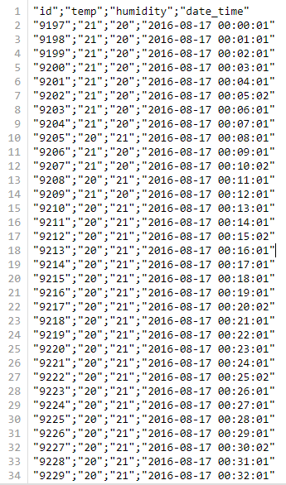
PROJECT DESCRIPTION
DATASET:

Slide 3
The dataset has 8,21,692 rows.
Contains each minute’s temperature and humidity recordings at Mohali’s server room.
Ranges from 2016-08-17 to 2018-05-24.
What can we obtain from this data ? (Objective)

Slide 4
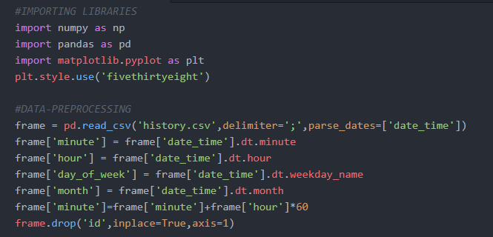
Data preprocessing:

Slide 5
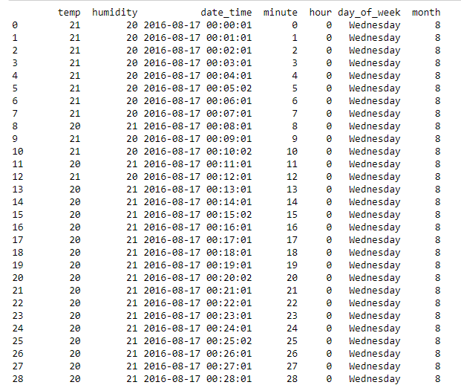
DATAFRAME:

Slide 6
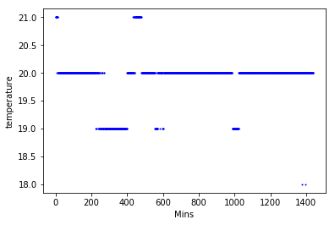
Temp vs time of the day graph for the first day of the dataset :

Slide 7
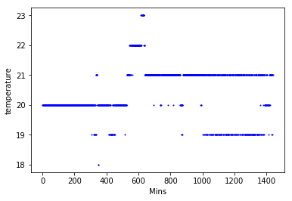
Temp vs time of the day graph for the second day of the dataset :

Slide 8
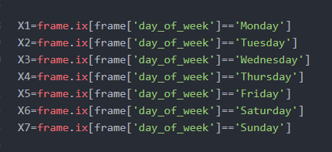
MAKING SEPARATE DATAFRAMES FOR DIFFERENT DAYS OF A WEEK:

Slide 9
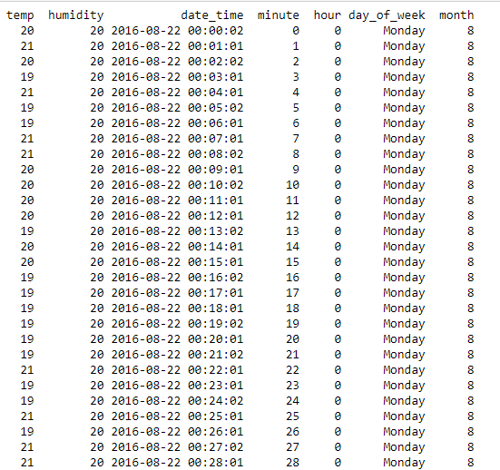
X1 :

Slide 10
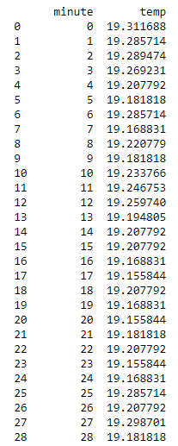

Plotting avg Temp vs time of the day for different days of the week:

Slide 11
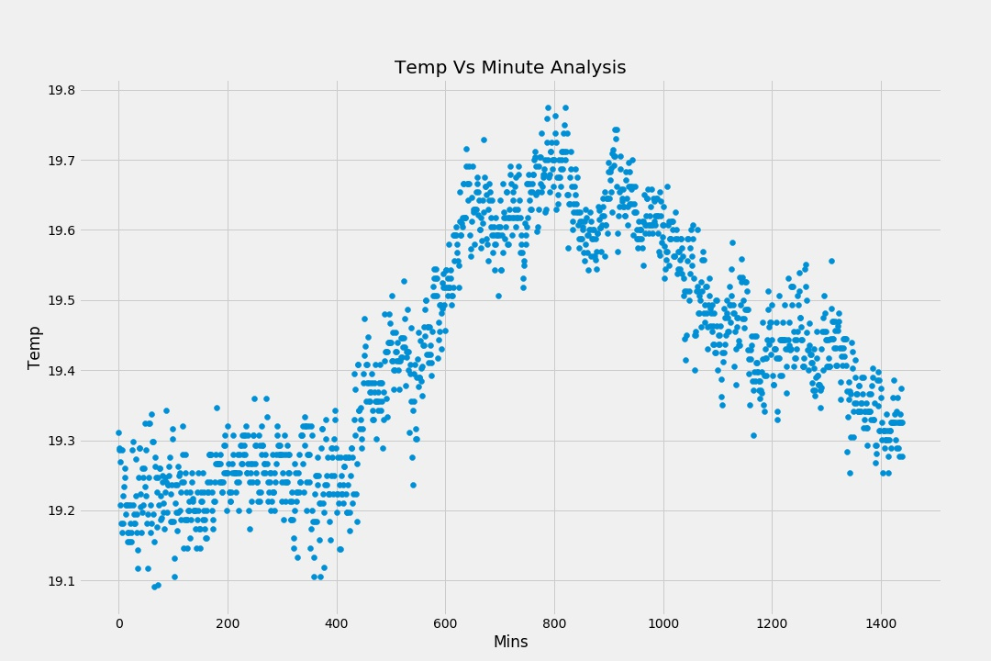
Monday:

Slide 12
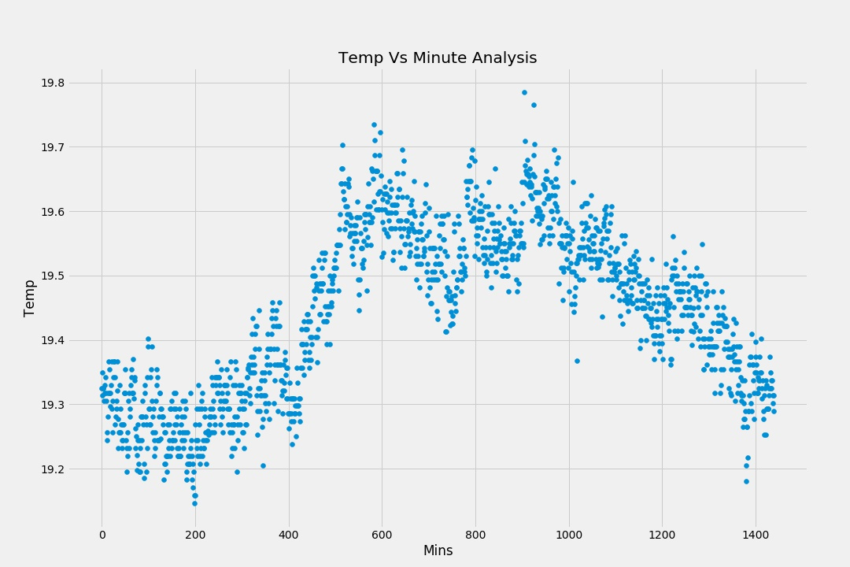
Tuesday:

Slide 13
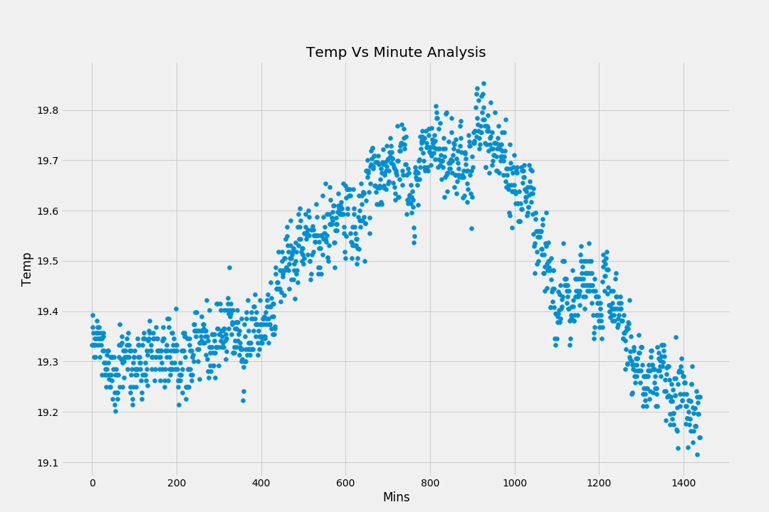
Wednesday:

Slide 14
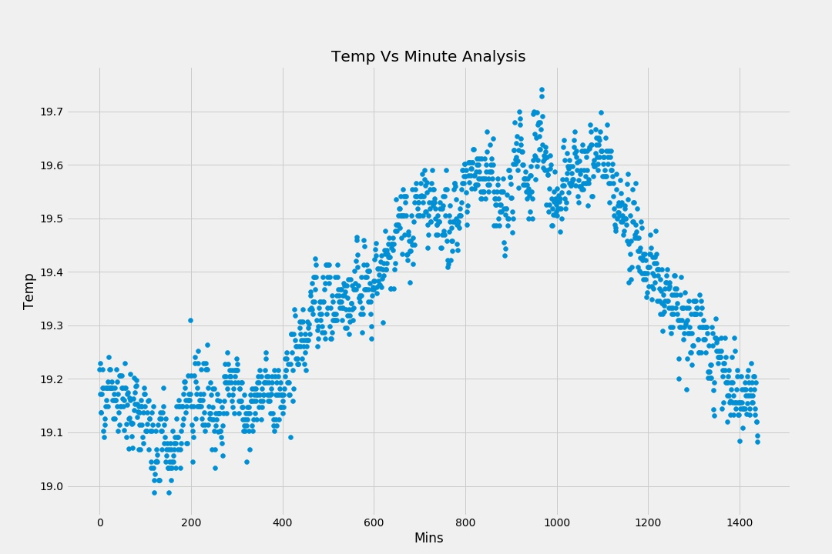
Thursday:

Slide 15
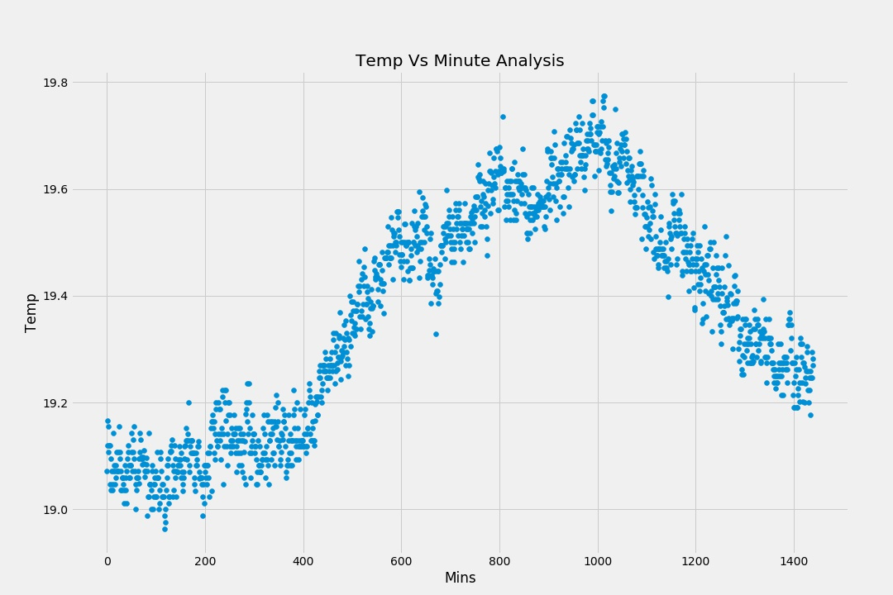
Friday:

Slide 16
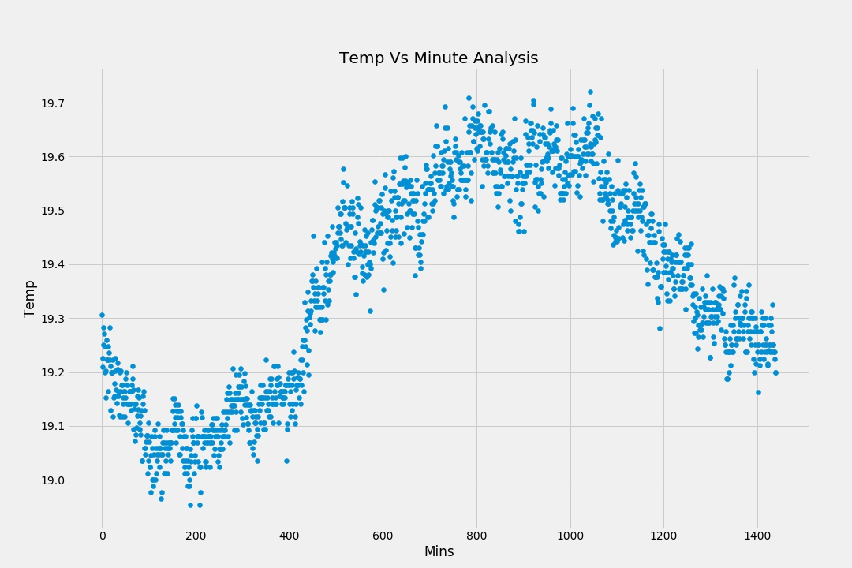
Saturday:

Slide 17
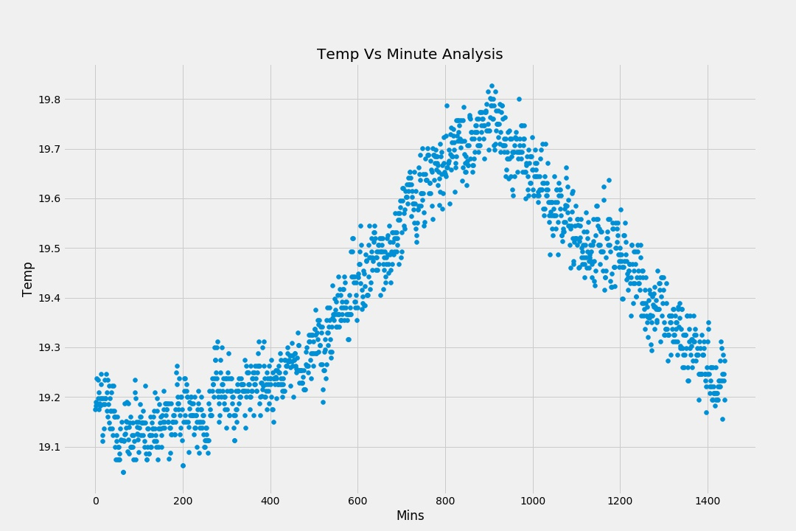
Sunday:

Slide 18
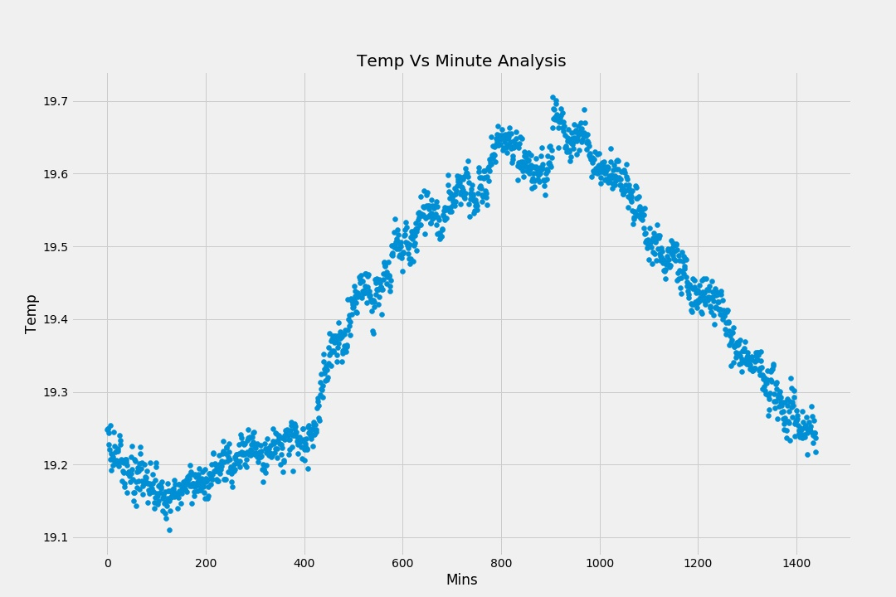
General day:

Slide 19
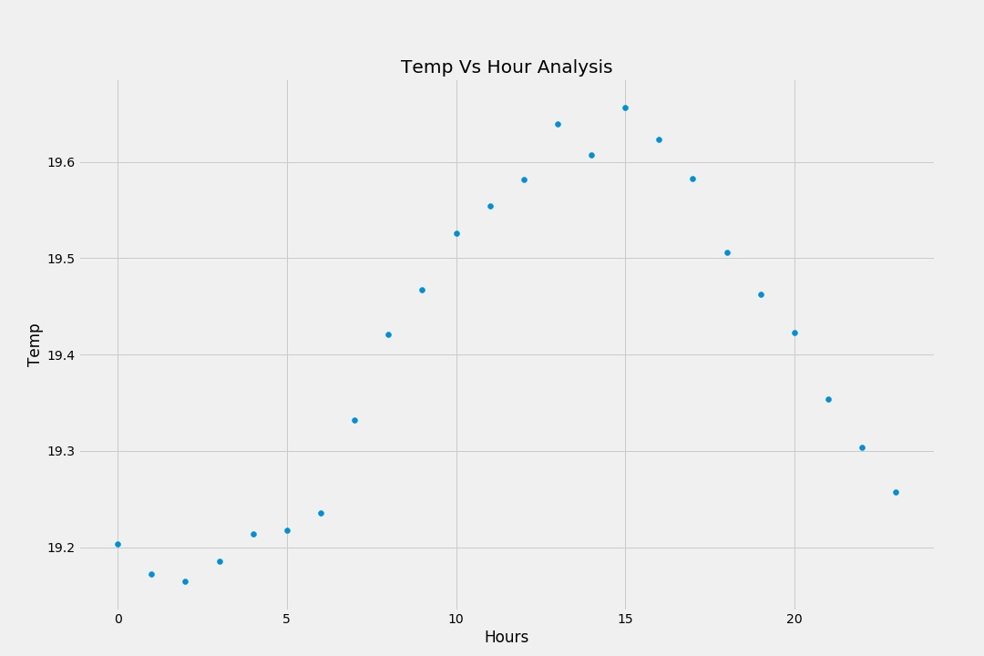
General day (hour wise):

Slide 20
Observations:
Plots are now smoother.
A polynomial relationship is observed in each of the plots.
Thus, a polynomial regression model can be built.

Slide 21
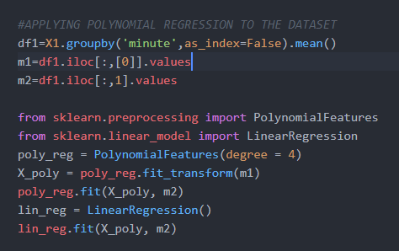
Building polynomial regression model:
Preparing dataset and training:

Slide 22
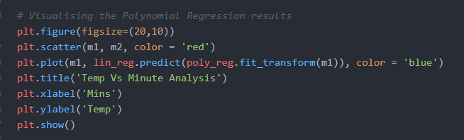
Visualization:

Slide 23
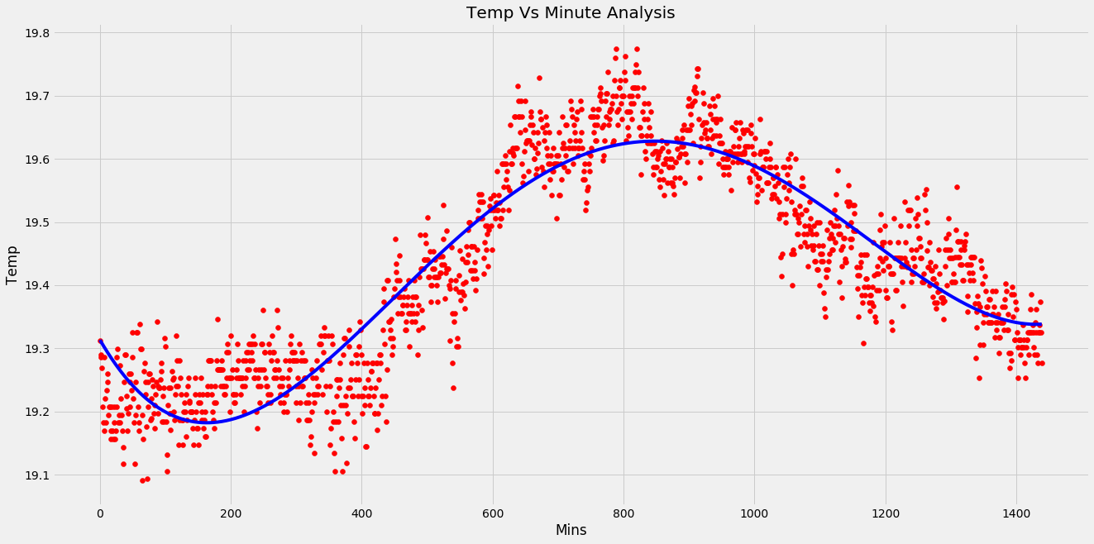
Monday:

Slide 24
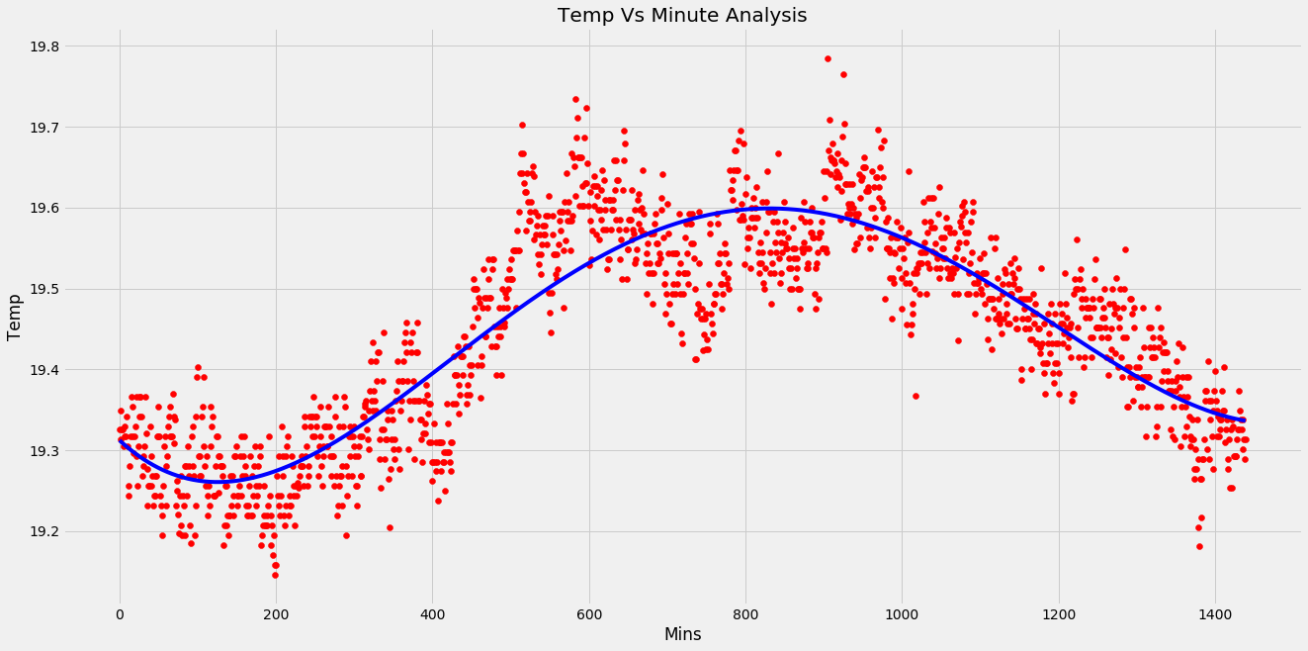
Tuesday:

Slide 25
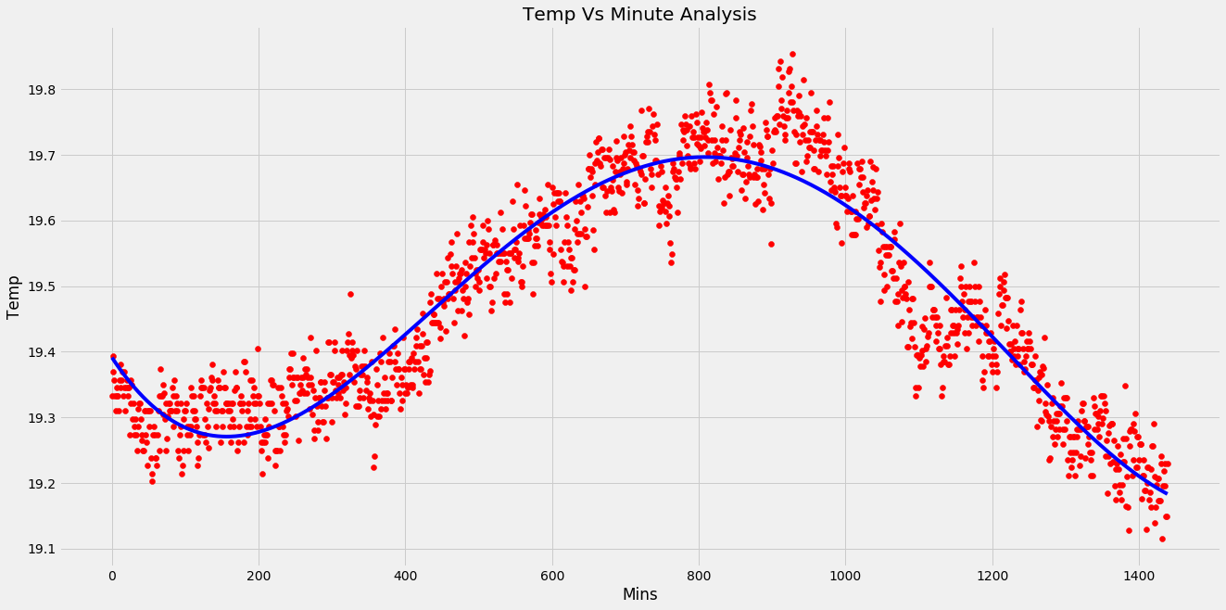
Wednesday:

Slide 26
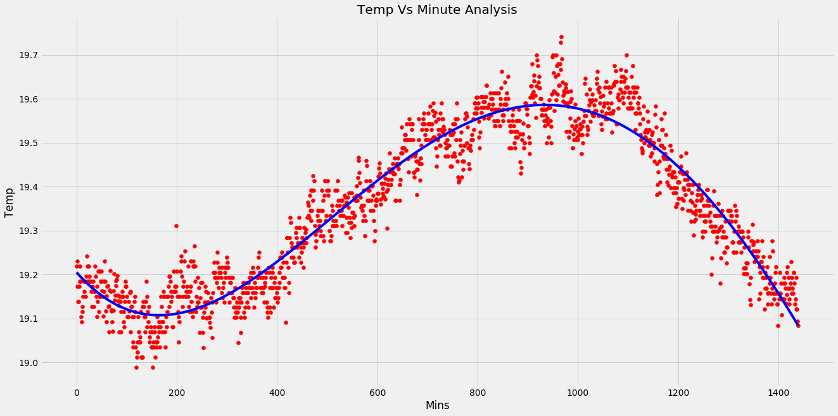
Thursday:

Slide 27
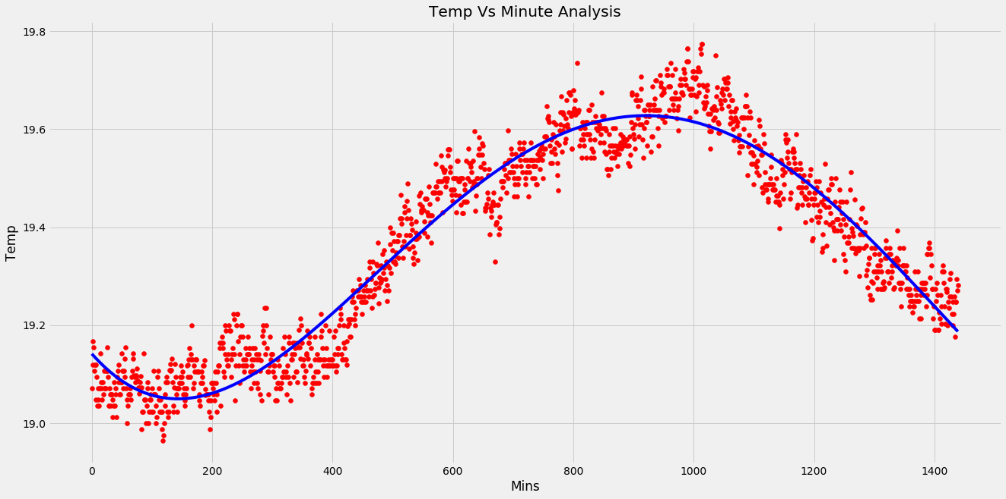
Friday:

Slide 28
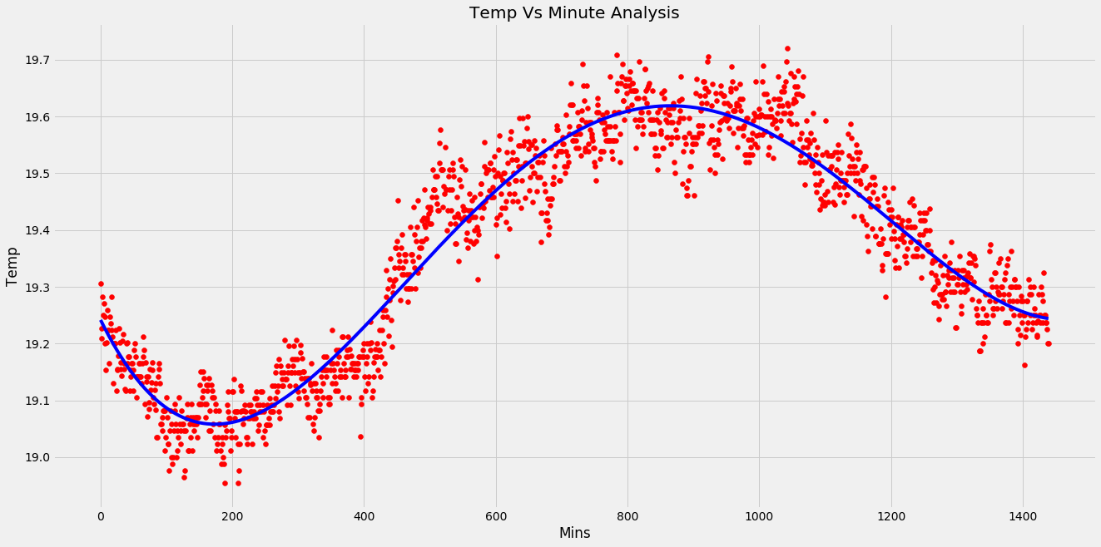
Saturday:

Slide 29
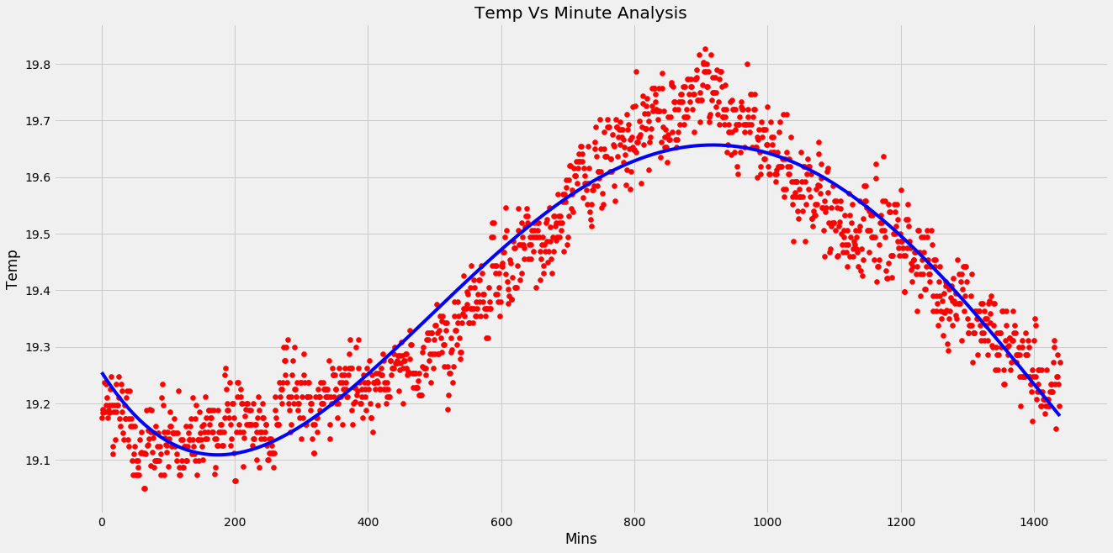
Sunday:

Slide 30
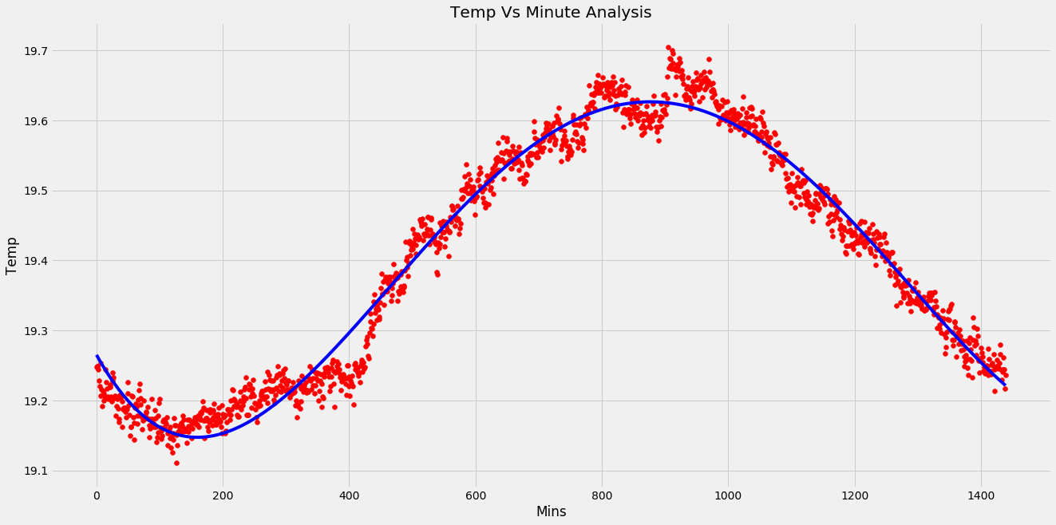
General day:

Slide 31
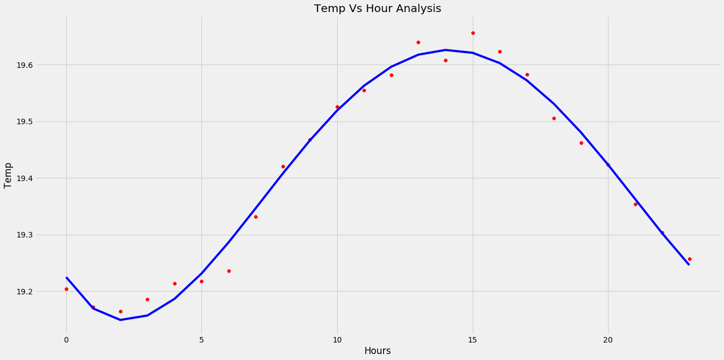
General day(hour):

Slide 32
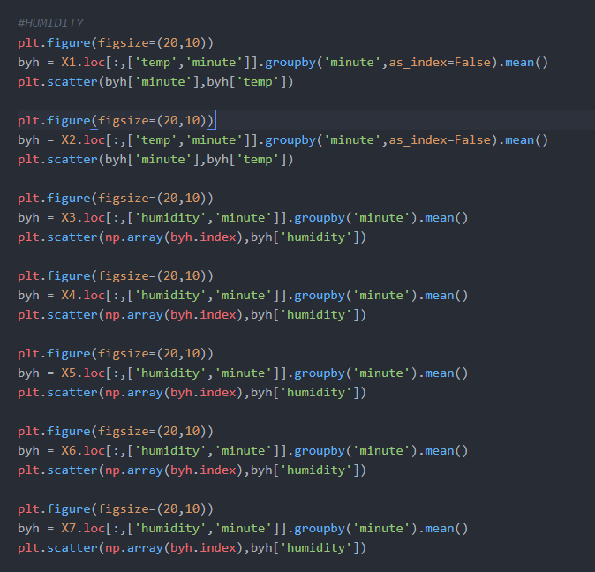
Humidity analysis:

Slide 33
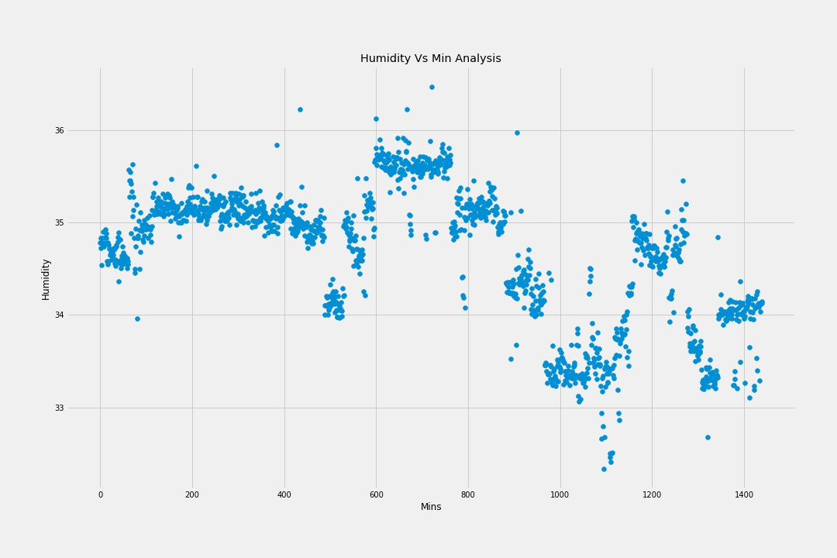
Monday:

Slide 34
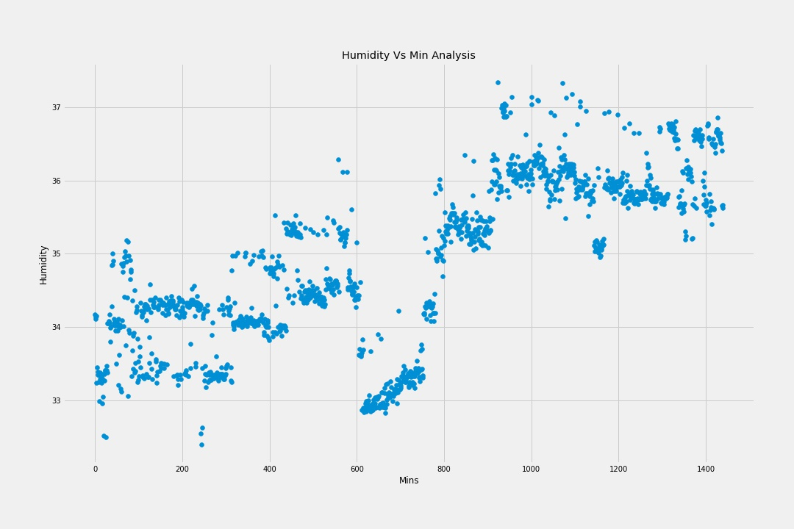
Tuesday:

Slide 35
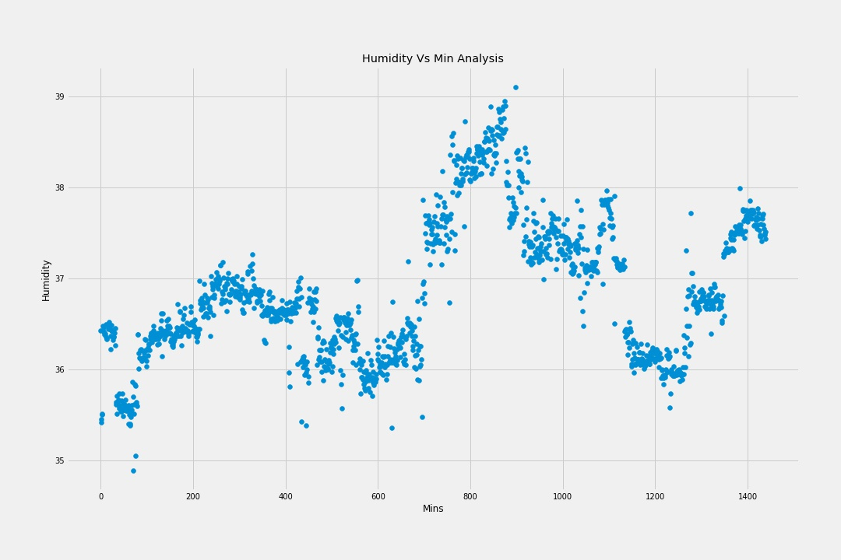
Wednesday :

Slide 36
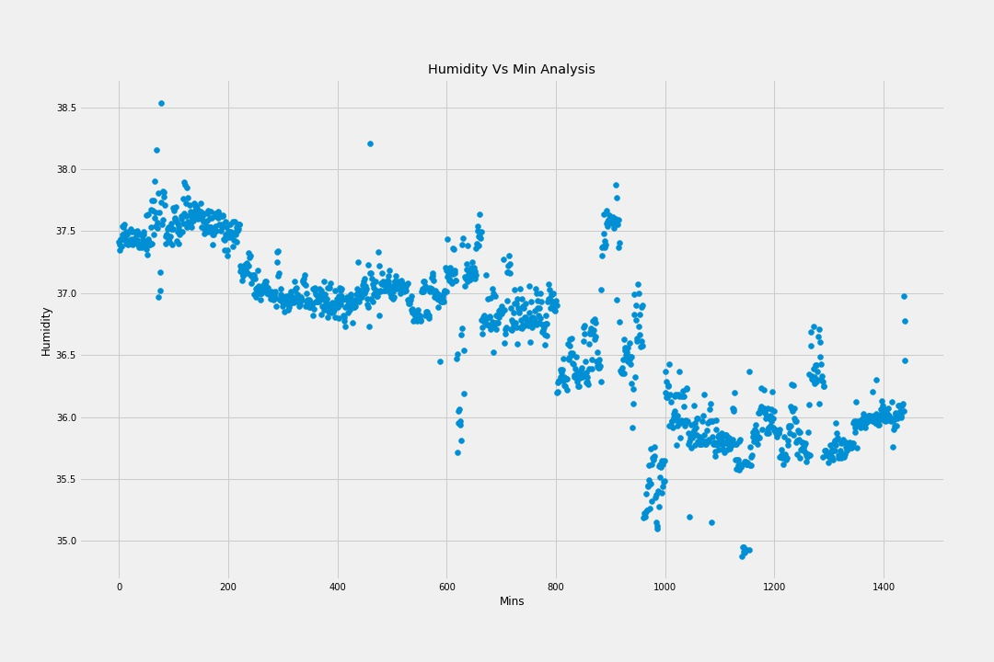
Thursday:

Slide 37
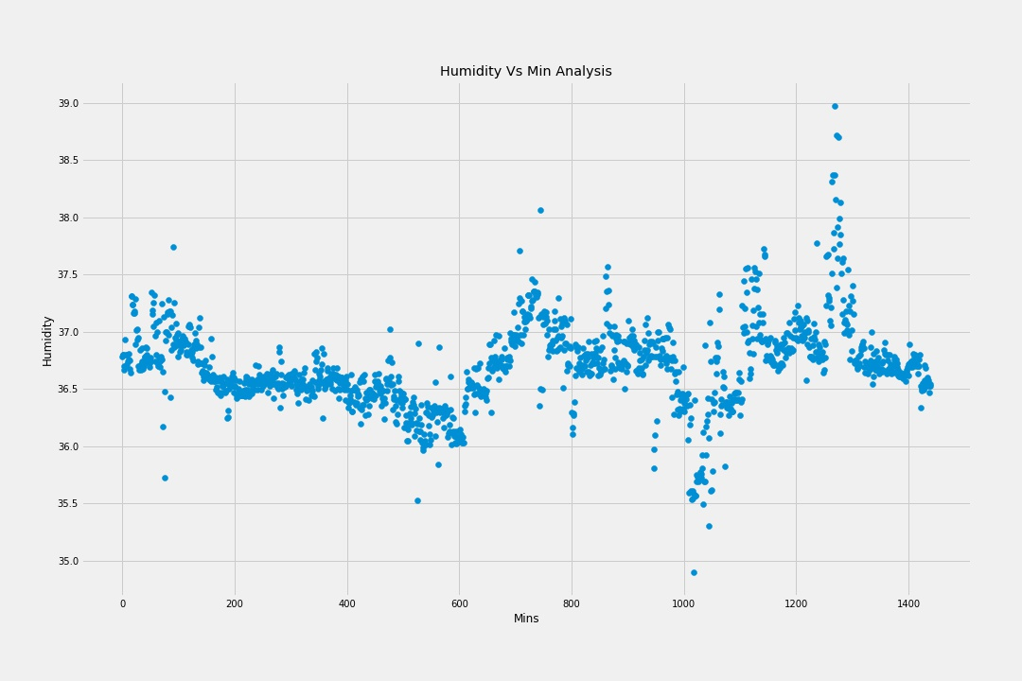
Friday:

Slide 38
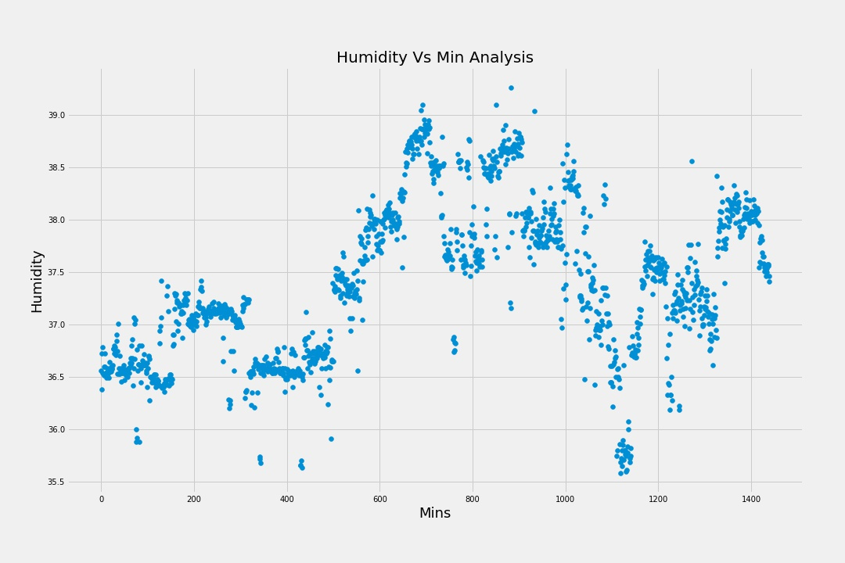
Saturday:

Slide 39
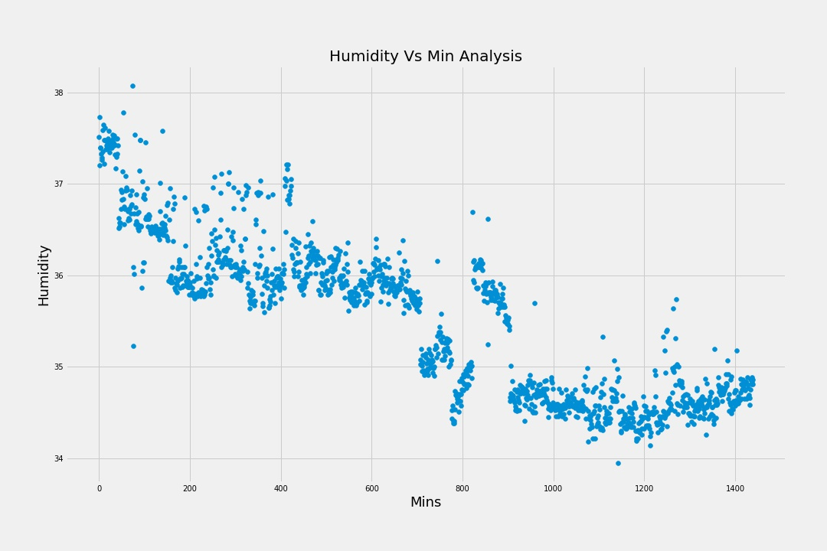
Sunday:

Slide 40
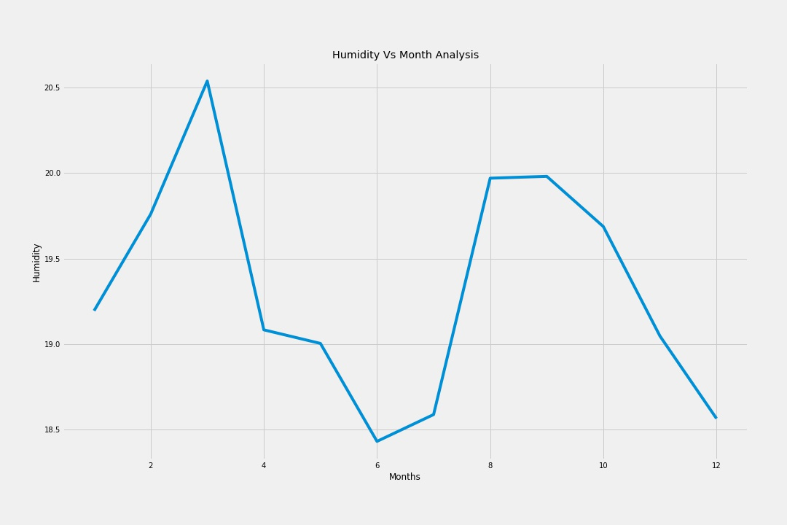
Month-wise:

Slide 41
CONCLUSION:
A polynomial model got developed that can be used to predict temperature values for a given time of a given date and it can be used by the company for future predictions.
However in the case of humidity, we were not able to spot any particular relationship between the time of the day and humidity value.

